Slide 1


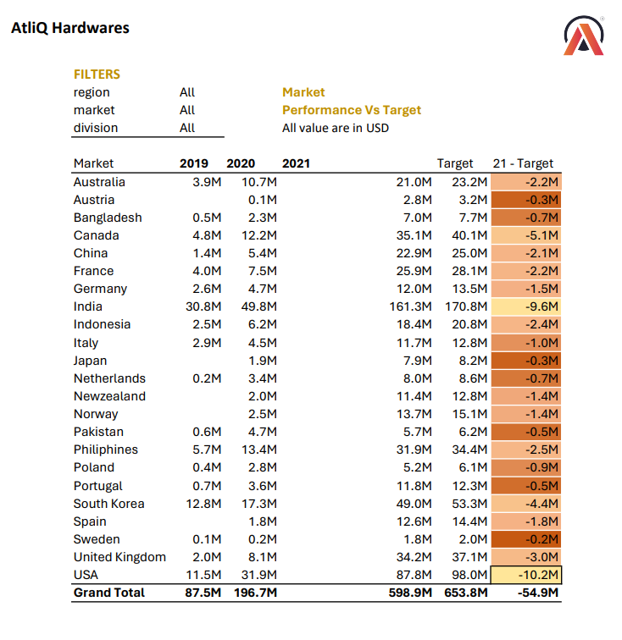
SALES & FINANCE
EXCEL REPORT
Presented By : Bilal Ahmed
Notes:
Links:
https://www.pexels.com/photo/pie-graph-illustration-669621/

Slide 2
CONTENT
Introduction
Problem Statement
Sales & Finance Report
Notes:
Links:
https://www.pexels.com/photo/man-using-dell-laptop-3197390/
https://www.pexels.com/photo/photo-of-ipad-on-top-of-wooden-table-3734603/

Slide 3
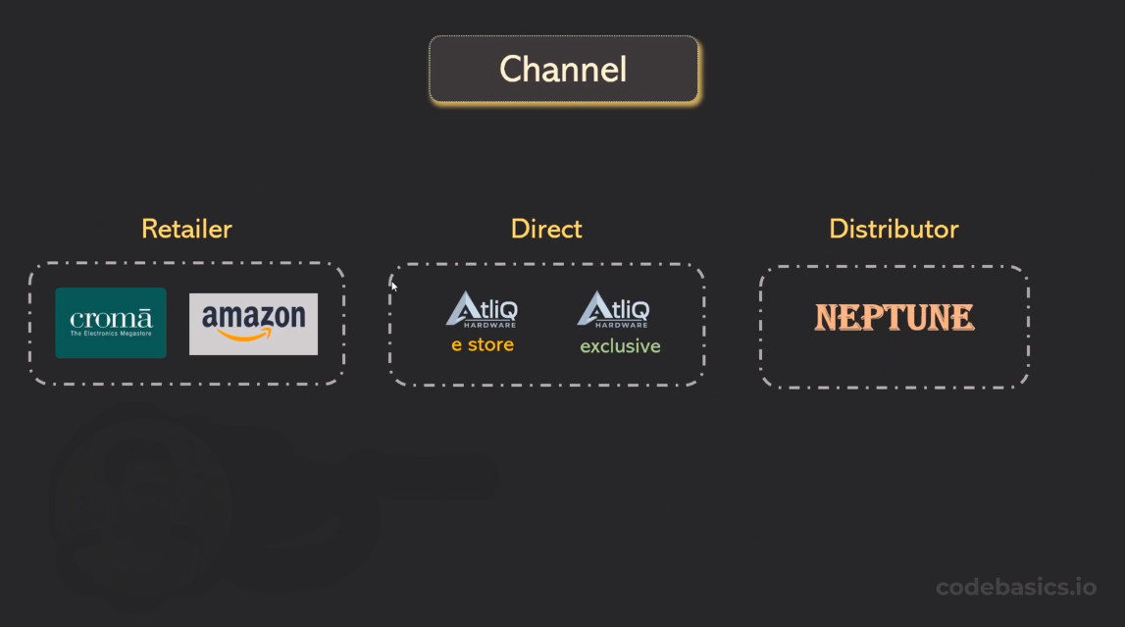
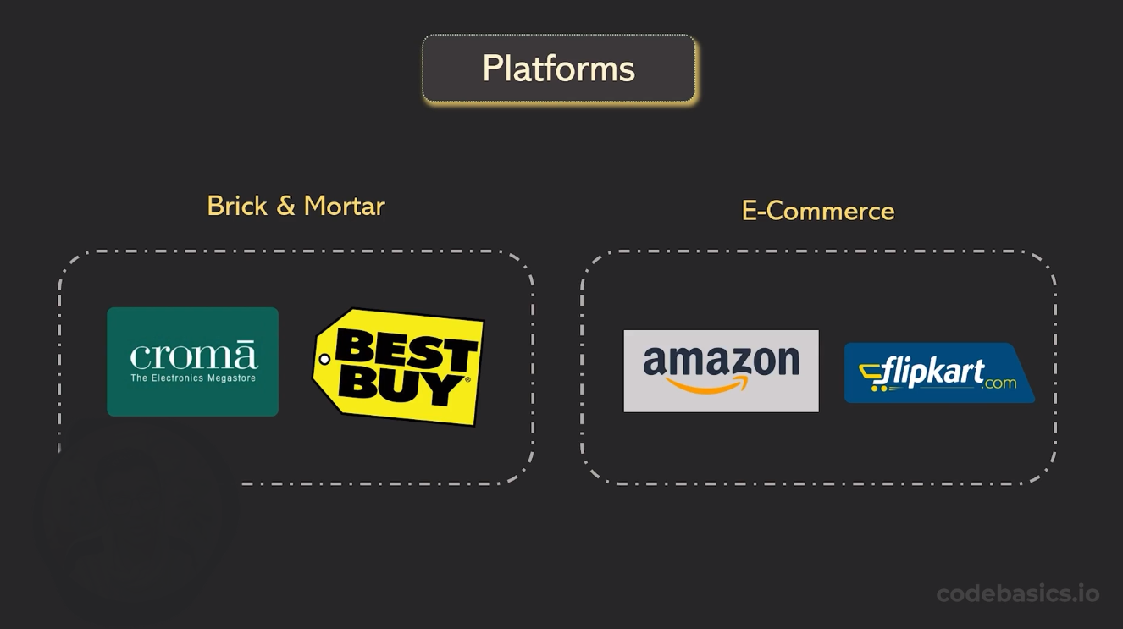
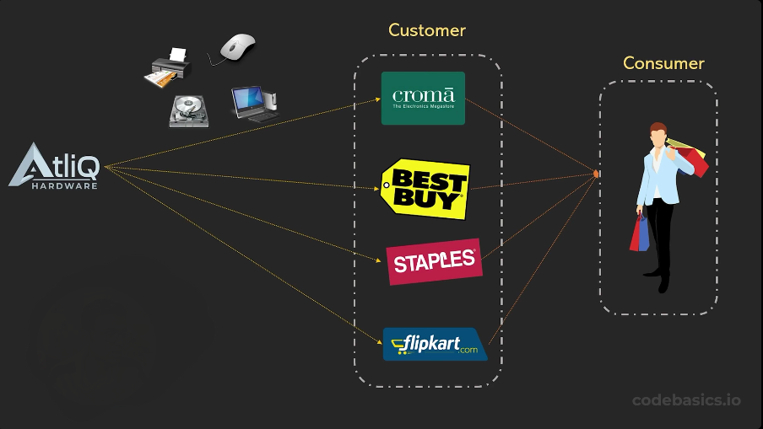
Introduction
Atliq Hardware is a leading company that supplies product such as computer hardware and peripherals to client across the world.
Notes:
Links:
https://www.pexels.com/photo/man-using-dell-laptop-3197390/
https://www.pexels.com/photo/photo-of-ipad-on-top-of-wooden-table-3734603/

Slide 4
Problem Statement
Altiq Hardware has been facing significant losses in recent years. Instead of relying on handwritten reports, they recognize the need for more insightful data to make informed decisions. As a result, they're requesting an Excel report to thoroughly analyze their sales and financial performance.
Notes:
Links:
https://www.pexels.com/photo/photo-of-people-using-laptop-3740173/
https://www.pexels.com/photo/photo-of-person-holding-tablet-3740170/

Slide 5
Reports
SALES
FINANCE
Customer Performance Report
Market Performance Report
Top 5 Product & Division
New Product & Top 10 Product
Top N Button 5 Product
P & L Yearly
P & L Market
P & L Monthly
GM % By Quarters

Slide 6


SALES REPORT

Slide 7
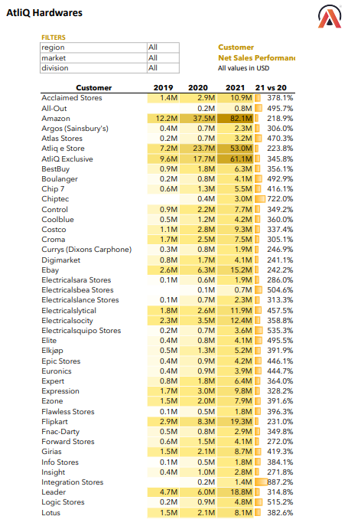
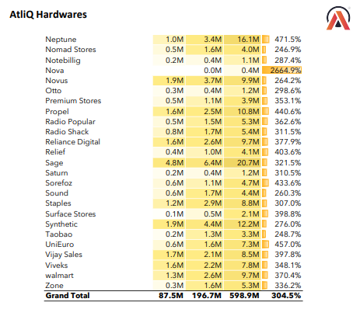
Customer Net Sales Performance
Notes:
Links:
https://www.pexels.com/photo/man-using-dell-laptop-3197390/

Slide 8
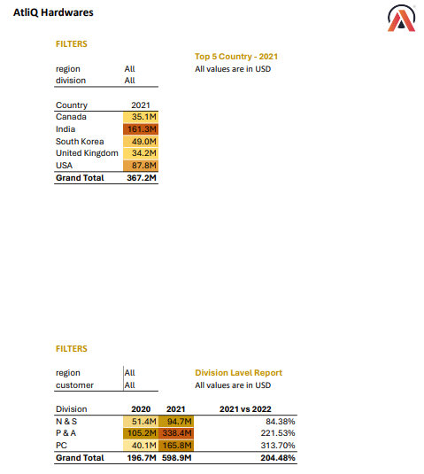
Market Performance | Top 5 Country| Division Level Report

Slide 9
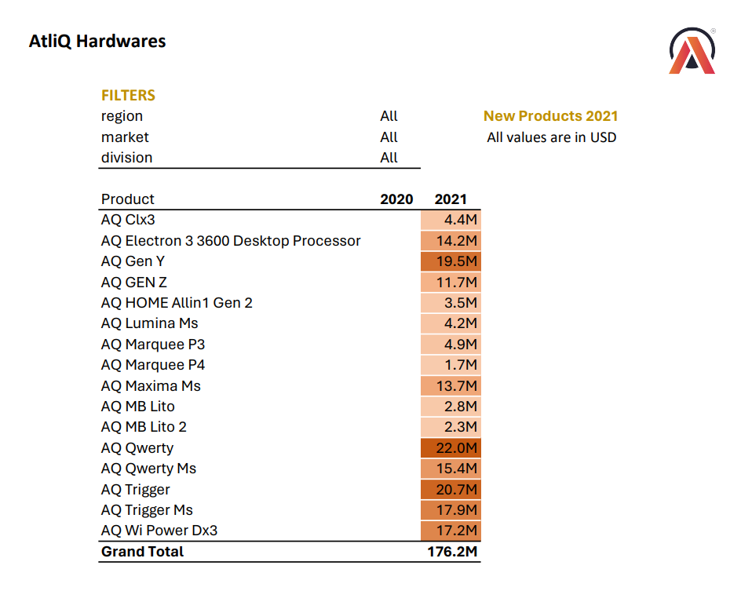
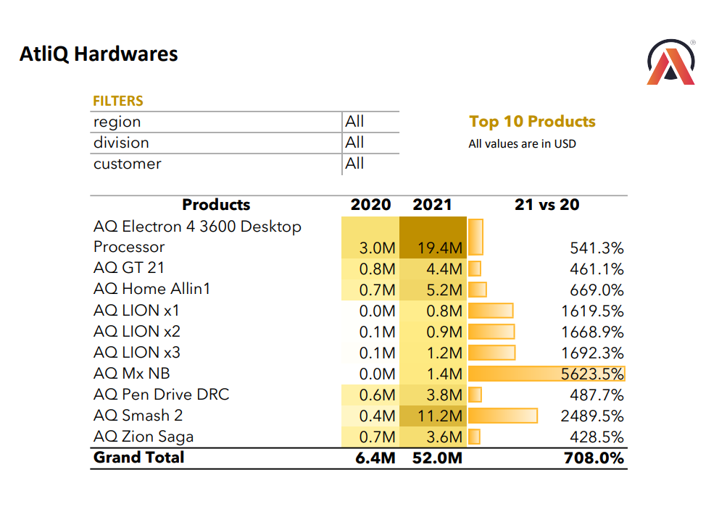
Top 10 Product and New Product

Slide 10
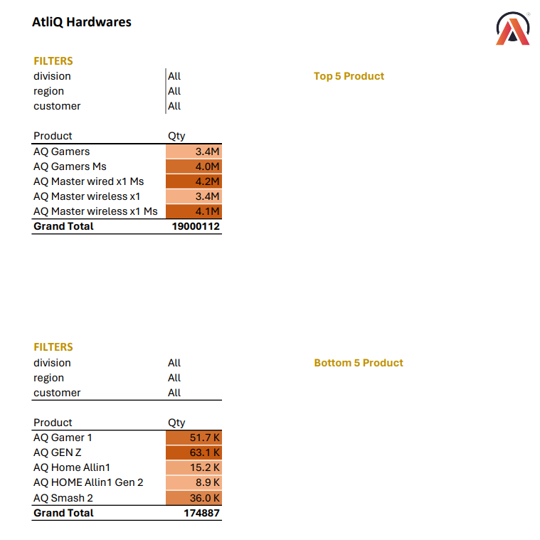
Top 5 and Bottom 5 Product

Slide 11
FINANCE REPORT

Slide 12
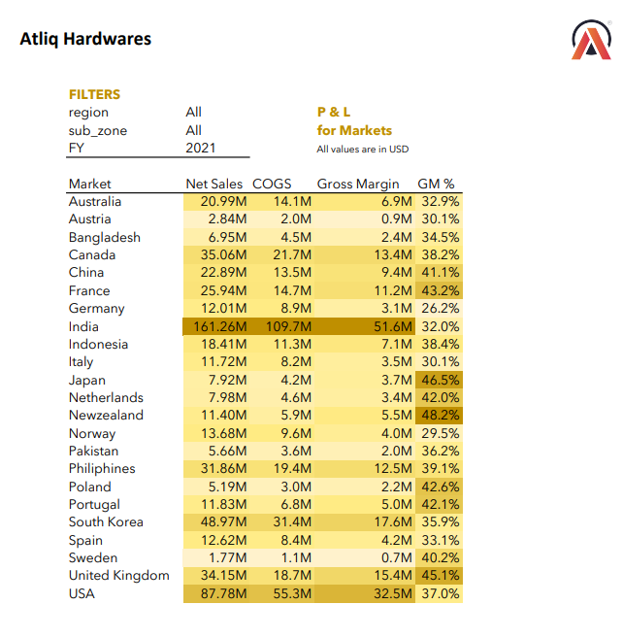
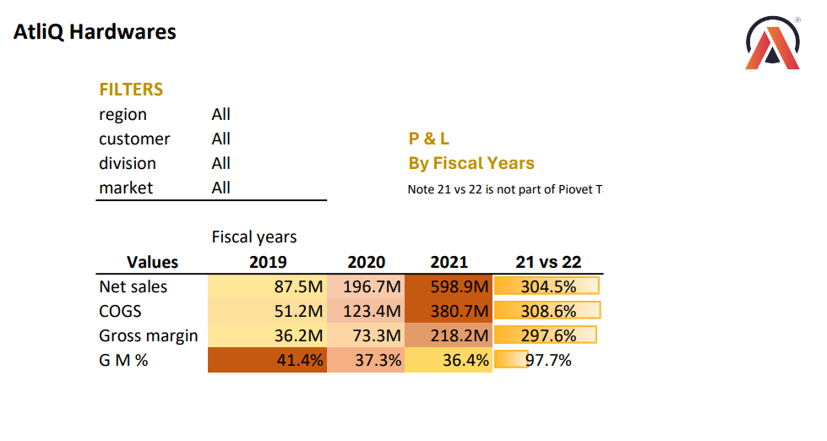
P & L By Fiscal Year And Markets

Slide 13
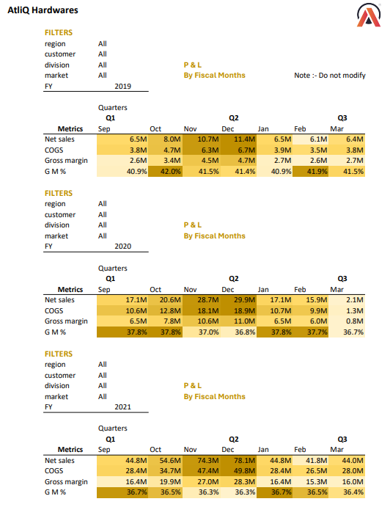
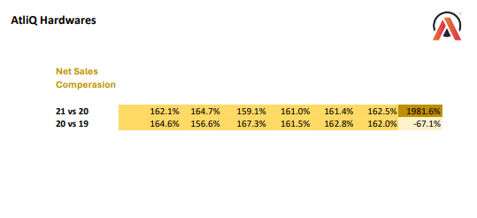
Profit And Loss Monthly

Slide 14
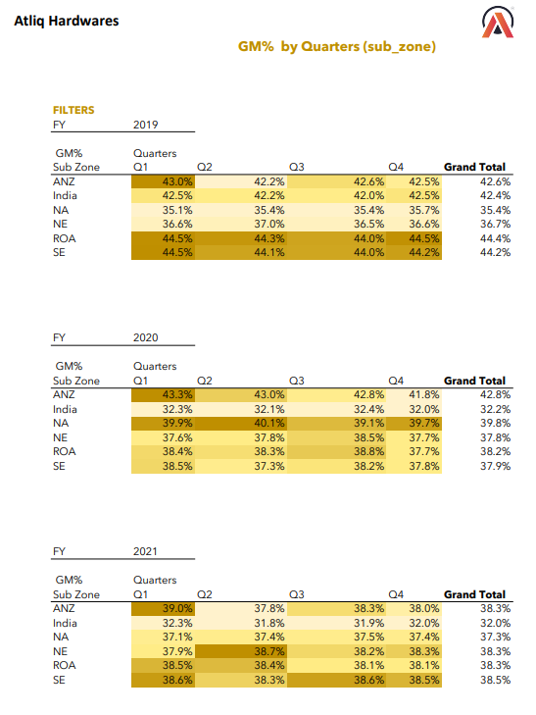
Gm % By Country

Slide 15
THANK YOU
Notes:
Links:
https://www.pexels.com/photo/pie-graph-illustration-669621/

